Slide 1
Working Together
Improving Chronic Pain Management

Slide 2
Learning Objectives
Roles of pharmacists working with primary care physicians in chronic pain management
Strategies to improve communication and collaboration
Prescribing strategies:
Bullet proof prescribing
Avoid common errors
Enhance education to patients
Pharmacist expanded scope
Narcotic monitoring strategy

Slide 3
Disclosures
Consultant Fees and Continuing Education Development
Purdue
Janssen
Takeda
Teva
Novo Nordisk
Apotex
Astra Zeneca
Apotex

Slide 4
Physicians and Pharmacists in Chronic Pain
Physicians
Pharmacists
Assess
Initiate
Educate
Monitor
Follow-up
Educate
Point-of-contact
Police system
Monitor

Slide 5
Collaboration in Pain Management
Interprofessional collaboration is recommended
Each profession brings a different skill
Pain management is “unique”
Challenge to control – 30% reduction target
Poor control for many patients
Diversion of truth may “benefit” patient – Abuse & aberrant behaviours
“fool some of the people some of the time…”
Pain is a condition where the information from one professional can have such a DRAMATIC effect on treatment

Slide 6
What Happens After you Write the Prescription

Slide 7
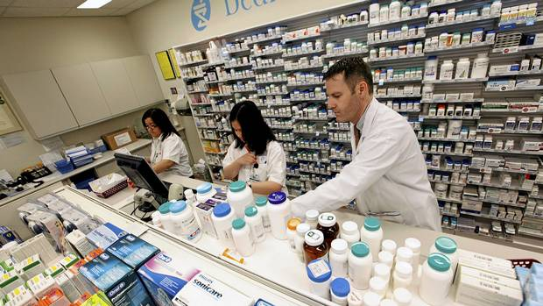
Your Opioid Prescription
Prescription received
Check ID (varies)
Familiar patient and physician?
“red flags”
Entered dispensing software
Insurance and NMS
Any warnings?
Fill the script – Double counted
Check – Education and counselling
Give to patient
Notes:
Prescription Received:
Phone
Fax
Patient
Familiar patient and physician
Do I have a history with the physician and the patient. If I don’t my “Fraudar” goes off.
I look at the patient’s file:
Have they had opioids before?
Does this make sense (dose and quantity)? (tip use normal quantities unless you inform pharmacists. “I only write for quantities ending in 3.” )
Dose in the right range based on patient’s history?
I think about the physician’s history?
Have they used this before?
Does the quantity make sense?
Could this be a forgery?
What does my gut tell me? Look at the patient. Everything seem ok.

Slide 8
What if my Gut or Information tells me there IS an Issue
How should I address it?
Is it worth the effort?
What will the prescriber think?
What will the patient think?
What if I am off the mark?
Is there significant proof?
Am I going to look stupid?

Slide 9
Pharmacist have Unique Perspective
More contact with patient
Daily, biweekly, weekly prescriptions
Highly accessible
Many questions – adverse effects
Suspicious by nature with opioids
Fraudulent prescription
Pharmacy staff “eyes and ears”
Can see patient behaviours regularly

Slide 10
Communication
We have to do better
Beneficial for physicians, pharmacists and most importantly the patient
Can’t make each other wait
Real-time – Patient is usually there
Opioid communication is often lumped into standard prescription requests
Determine special words or phrases
“Issue with a narcotic prescription…”
“Problem with an opioid”
“Question on opioids…”

Slide 11
Improving Communication – Start to Finish
Not just about calling when the prescription is filled
Good communication starts before the script is written to after it is picked up
Clarity and consistency is so important
Make my life easier and I will have time to do the same for you

Slide 12
Before Writing a Prescription
Know your patient and coverage
≥ 65 years, Trillium or social assistance
Watch tramadol, buprenorphine, pentazocine, hydromorphone ER once daily, tapentadol
Limited use codes (meperidine, fentanyl, celecoxib)
Coverage does NOT mean true coverage
DON’T say “do you have a plan?”
Say - “Do you have a plan through your current or former employer?”
Let the patient know the cost ahead of time
Know approximate cost (NOT from manufacturer rep)
Stress the importance of a single pharmacy
Especially part-fill prescriptions
All opioids on one script, regular meds on another
Notes:
Part-fills – no transfer

Slide 13
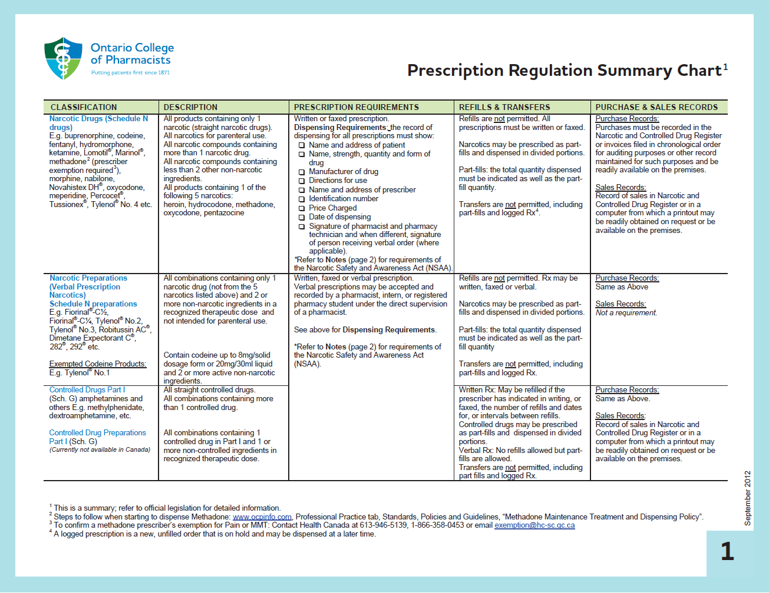
Know the Opioid Regulations
http://www.ocpinfo.com/library/practice-related/download/Prescription%20Regulation%20Summary%20Chart%20%28Summary%20of%20Laws%29.pdf

Slide 14
Meet John Smith
John Smith (32 yo)
Chronic back pain, post work injury
Was on NSAID therapy, not controlling pain
He is a good candidate for opioid
Followed all of the guideline recommendations for opioid use
Opioid is going to be prescribed
Excellent care but poor writing of a prescription

Slide 15
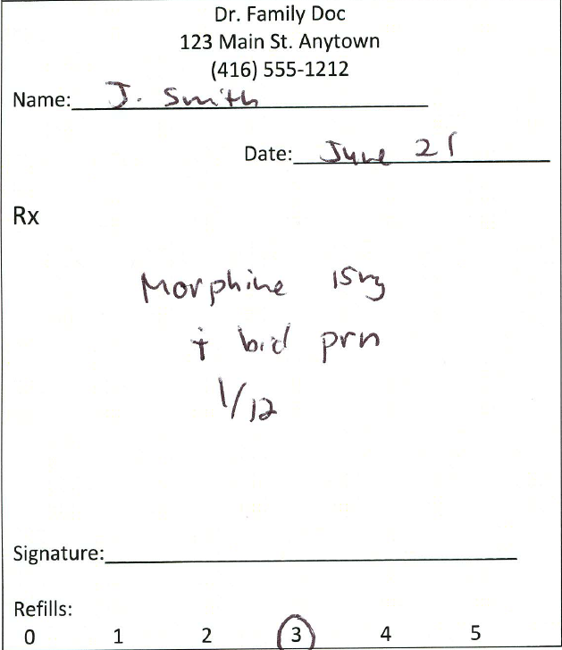
How Many Errors can you Find?
Name not in full
Date not in full
Morphine not identified as SR
PRN and 1/12 or 1/52
Computer generated signature
Refills
Missing – CPSO Number
Missing – Patient ID
F.Doc

Slide 16
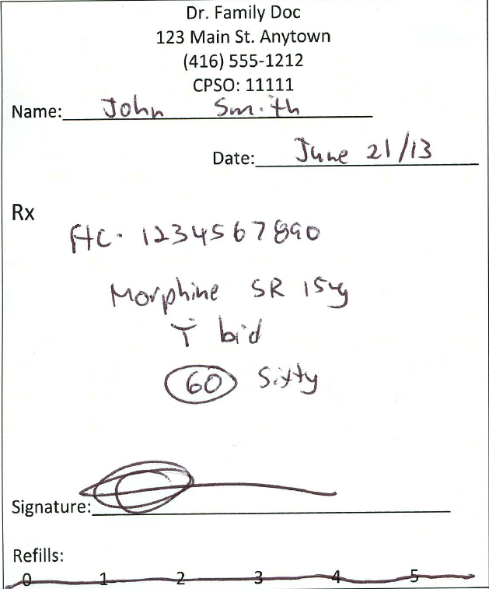
Basics – Opioid Prescriptions
CPSO Number
Name and Date
Health Card Number
Drug, dose, instructions
Quantity
Signature
Refills
Notes:
Discuss:
Name and date – No short forms, full dates and NO post dating
ID
Ontario Health Card or other health card issued by a Province or Territory in Canada
Valid Driver’s Licence or Temporary Driver’s Licence (issued by Ontario or other jurisdiction)
Ontario Photo Card
Birth Certificate from a Canadian province or territory
Government-issued Employee Identification Card
Ontario Outdoors Card
BYID (age of majority card)
Certificate of Indian Status
Valid Passport – Canadian or other country
Certificate of Canadian Citizenship
Canadian Immigration Identification Card
Permanent Resident Card
Old Age Security Identification Card
Canadian Armed Forces Identification Card
Royal Canadian Mounted Police/Provincial/Municipal Police Identification
Firearms Possession and Acquisition Licence
Drug and sig
Prefer writing brand – Easily can tell what you want – MS contin and M-eslon, brands of tramadol CR, Hydromorph contin/jurnista, Generic oxycodone CR/Oxyneo
NEVER use as directed
Quantities
Number and written with or without roman numerals
DON’T write for 1/12, 1/52
Signature
Full, NOT computer generated
Refills
Not valid – so don’t even think about it

Slide 17
Prescription is a Great Method of Communication to Pharmacists
Ancaster-Dundas Physician-Pharmacist Collaboration Project
Methods to improve communication and reduce workload for both professions
Found that with simple notes on the prescription it:
Can reduce unnecessary calls and faxes
Can enhance patient care
Let’s look at common examples
Notes:
Ancaster-Dundas, Physician-Pharmacist Collaboration Project

Slide 18
Meet Judy Smith
35 yo old patient
Chronic neck pain, post automobile accident
Patient is currently taking:
Oxycodone CR 20 mg Q12H
BPI is indicating pain is not well controlled
Low risk of opioid abuse
Want to increase the dose of oxycodone CR to 30 mg Q12H

Slide 19
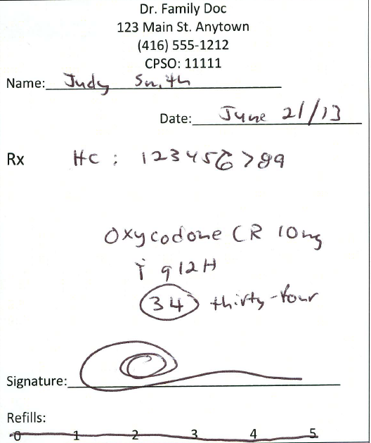
Prescription Written
Patient has approximately 15 days of 20 mg left, so prescription is written for enough 10 mg to last until next appointment.
Prescription is completely legal
What are the potential Issues?
Dose increase or decrease?
Weird quantity – Forgery?
Brand or Generic?

Slide 20
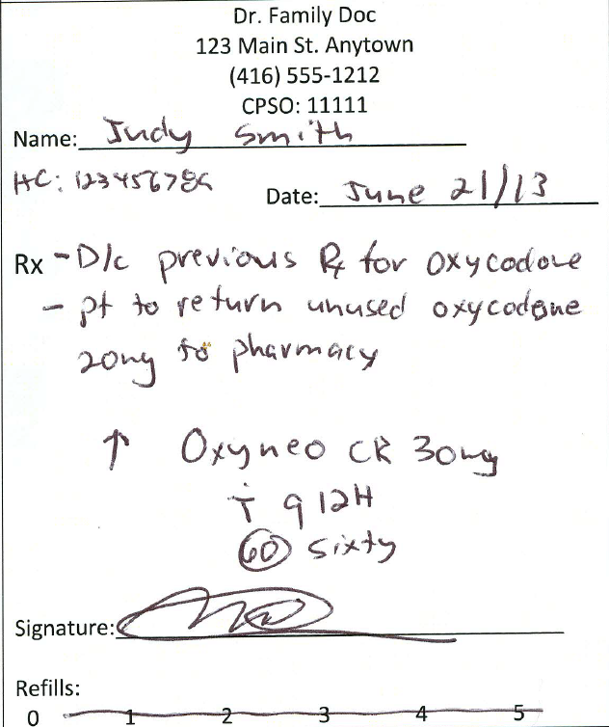
Dosage change
Simple and clear communication
Remove risk of unused opioid in patients home
ALWAYS add the arrow
↑ ↓ - Can reduce your calls
Pharmacist uses this information when counselling patient
Use this for Post-Dating scripts

Slide 21
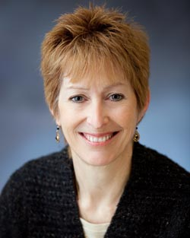
Meet Joanne Smith
Chronic pain
Full assessment and deemed a candidate for opioid therapy
Want to initiate a trial of hydromorphone CR
Patient lives out of town (50 km from office) but has been your patient for years
Patient says she is going to fill the first prescription at the pharmacy downstairs

Slide 22
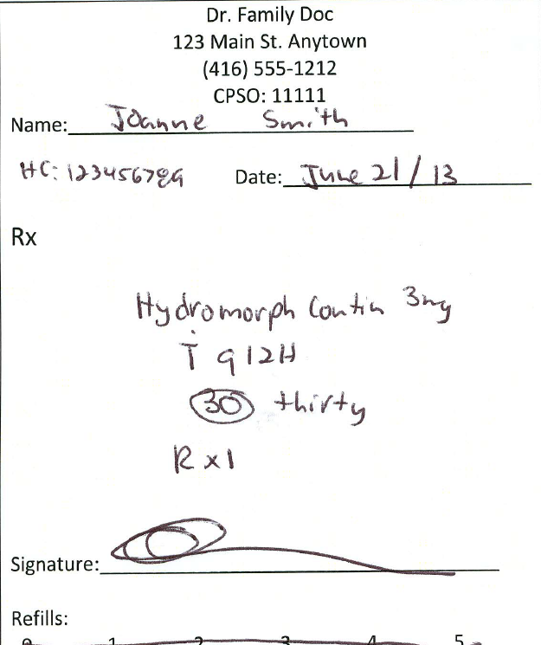
Part-fills and Transfers
Two issues:
Refills
Transferring of prescriptions
This prescription is NOT legal for second fill

Slide 23
Part-Fill
Which of the following is legal to refill three times by circling refills on the prescription or writing (R X 3)
Oxycodone
Tramadol
Benzodiazepines
Testosterone
Methylphenidate
Tylenol #1
Zolpidem and Zopiclone
Only with date or interval

Slide 24
Part-Fills
Legal for ALL prescriptions
Can use for any prescription medication (e.g. thyroxine, ACE, statins)
Total quantity of prescription plus date or interval
http://www.timeanddate.com/date/
Hydromorph Contin 3 mg M – 60 (Sixty) Dispense – 30 capsules on June 21/13 30 capsules on July 6/13 | Hydromorph Contin 3 mg M – 60 (Sixty) Dispense 30 capsules Q 15 days

Slide 25
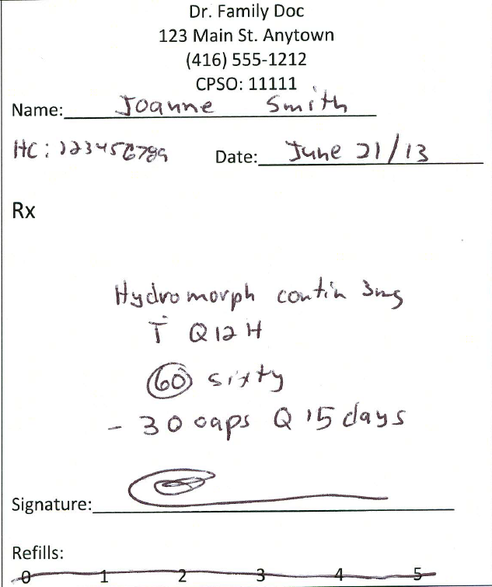
Rewrote Prescription
Sees pharmacist downstairs and refers patient back to physician
Inform patient of interval
Cannot receive early
Transfers of opioids and controlled drugs NOT valid
Exception - tramadol
Transfer of BZD’s only ONCE
BZD refills are only valid for 1 year from the original prescribed date

Slide 26
Meet James Smith
43 yo with chronic osteoarthritic pain
Candidate for opioid therapy
Patient says he is allergic to all narcotics
Describes allergy as GI upset to codeine and meperidine
Strictly intolerance and NOT allergy

Slide 27
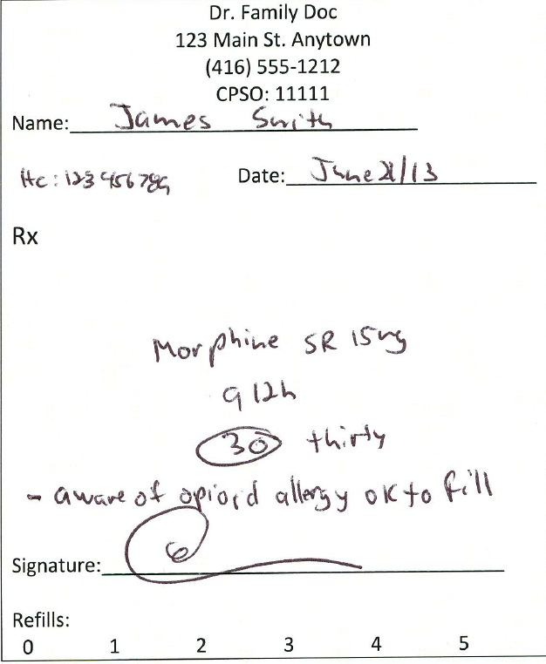
Allergy and Drug Interactions
Patient will many times not remember your conversation
Pharmacist will want to verify
Mark if you are aware of allergy
Mark if you are aware of drug interaction
Tramadol and SSRI’s

Slide 28
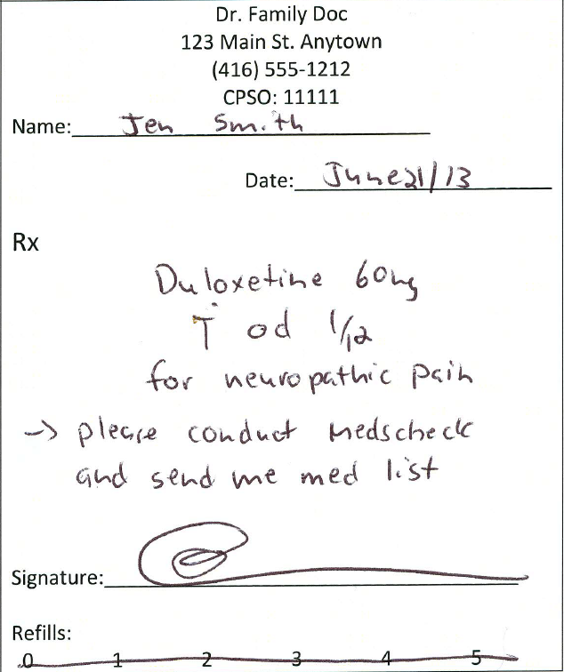
Indications, Pharmacist Services
Drugs with many indications write indication to enhance counselling
TCAs, SNRIs, Pregabalin, SSRIs, any multiple indication therapy
Referral to pharmacy services
MedsCheck
Diabetes MedsCheck
Disease management program

Slide 29
Verbal Prescriptions
Codeine with 2 more ingredients, controlled drugs, BZDs
Fiorinal®, Adderal®, Concerta®, Tylenol #3®, Ativan®
Refills are NOT valid (exception BZDs)
Don’t say “give them 2 refills”
Part-fills ARE valid
Tell them the total quantity and interval or dates
Not a race to get off the phone – Can replay on voice mail
Don’t forget health card #, CPSO #, Phone number (backline)
Easier now to fax prescription

Slide 30
Fax Prescriptions for Opioids
Specific Fax stamp
Change it up – notify pharmacies
Date
Sign prescription and ideally quantity
Consider writing in pen on the script
“To be filled at…”
“Faxed to…”
“if any issues please call…”
Notes:
EMRs make it very easy for physicians but very easy to fax same RX to multiple pharmacies.
I love faxed scripts but here are some issues.

Slide 31
Communication Preferences

Slide 32
Communication Questions
We will ALWAYS call to clarify unclear prescriptions
How much information do you want from other HCPs?
Suspicious behaviour?
Things seen in the pharmacy – “can’t believe he is fooling his doctor”
Therapy suggestions?
Adverse effects?

Slide 33
Let us Know and Make it Easy
Meet or call key pharmacists in your area
Discuss your concerns with opioid prescriptions
Discuss the level of communication you want
Remember when it comes to opioids, patients may not share
Not about refills or early fills but REAL issues
Discuss the ideal method of communication
Phone – Cell phone, back line, Text to call the pharmacy
Fax – Need a fast turnaround
Work together to reduce risk and enhance patient care

Slide 34
Pharmacist Expanded Scope

Slide 35
Pharmacist Refills
Chronic disease conditions and patient tolerating therapy well
Can refill up to original quantity prescribed or 6 months
Takes on liability for prescription
Will notify prescriber and primary healthcare provider (if different)
Does NOT apply to targeted substances (e.g. opioids, controlled drugs, BZDs)
Can be useful for situations such as MD holidays
In pain management applies to: NSAIDs, SNRIs, TCAs, PPIs, Gabapentin/Pregabalin

Slide 36
Pharmacist Adaptation
Pharmacist can “adapt” the prescription based on the circumstances by altering dose, dosage form, regimen or route of administration
Not therapeutic substitution – no change to other drug
Takes on liability of new prescription
Examples – tablets/capsules to liquid, adjusting dose of pediatric antibiotics, sig written for QID but dosed BID
Inform prescriber if clinically significant – Judgement call
Does NOT apply to targeted substances

Slide 37
Pharmacist Opinion
Pharmacist makes a recommendation to physician to address:
Therapeutic duplication; drug may not be necessary
Requires drug; needs additional drug therapy
Sub-optimal response to a drug
Dosage too low
Adverse drug reaction
Dangerously high dose; potential overuse; abuse
Non-compliance / Adherence
Confirmed forgery or falsified prescription
You can agree or not
If on ODB, the pharmacist is paid
In pain management this could apply to almost any aspect including pain control, adverse effects, forgery, abuse, etc.

Slide 38
MedsCheck
Provides “best possible medication history”
All prescription drugs
All OTC drugs
Any natural health products – vitamins and herbs
Can be customized for pain management – Talk to pharmacist
Analgesic history
BPI, ORT
3 chronic medications – all people of Ontario
Prescribe it just like anything else, include in EMR software

Slide 39
Narcotic Monitoring System
Notes:
Brent Fraser - Director at Ministry of Health and Long-Term Care

Slide 40
Good, Bad, Ugly
Good
Help identify patients double doctoring
Identify patients that could be “problems” before they occur
Suspected risk will now lead to an answer
Bad
Tracking everything we do
Adds some workload for all professionals
Ugly
Start tracking prescribing and dispensing (“Big Brother”)
Claw-backs for non-compliance

Slide 41
Writing a Prescription
Any benzodiazepine, controlled drug, opioid or tramadol
Record one of 16 forms of ID on the prescription
Recommend health card only
Federal versus provincial databases
Passport at one office, health card at another
CPSO number is crucial
We may know it but we can’t add it for you
Encourage it for all scripts
Reduce phone calls (especially walk-ins, ER, or multi-physician practices)

Slide 42
Prescription at the Pharmacy
Patient/3rd party drops off prescription
Based on current legislation
Pharmacist must check that the ID number is on the script (health card number)
Verify prescribers CPSO number is on the script
We do NOT HAVE to check the patient’s ID
Know the patient it is ok
We CAN ask to see the ID from the patient to confirm identity

Slide 43
Third Party Pick-up
Trying to prevent one patient getting a prescription and an unauthorized person picking it up
We collect the ID information and address of any person that picks up the medication that is not the patient
This is stored with the patient script and is subject to audit

Slide 44
What is Happening with the Data?

Slide 45
NMS Data – Oct 31, 2013
All 3,600+ pharmacies in Ontario are submitting dispensing data about monitored drugs to the NMS. As of
October 31, 2013 , the NMS has received:
About 39.9M submissions
Submissions for over 3.2M different patients
Submissions attributed to over 54,000 different prescribers
http://cpso.on.ca/getattachment/CATs/CPSO-Members/Related-Links-Methadone-Program/Narcotics-Monitoring-System-Ontario.pdf.aspx

Slide 46
Methadone Jan 2011-Feb 2013
http://cpso.on.ca/getattachment/CATs/CPSO-Members/Related-Links-Methadone-Program/Narcotics-Monitoring-System-Ontario.pdf.aspx

Slide 47
Oxycodone – Jan 2011 to Feb 2013
http://cpso.on.ca/getattachment/CATs/CPSO-Members/Related-Links-Methadone-Program/Narcotics-Monitoring-System-Ontario.pdf.aspx

Slide 48
Benzodiazepine April 2012 to March 2013
http://cpso.on.ca/getattachment/CATs/CPSO-Members/Related-Links-Methadone-Program/Narcotics-Monitoring-System-Ontario.pdf.aspx

Slide 49
Watchful Dose Calculations
http://cpso.on.ca/getattachment/CATs/CPSO-Members/Related-Links-Methadone-Program/Narcotics-Monitoring-System-Ontario.pdf.aspx

Slide 50
Actions Taken to Date
Communications to pharmacies regarding the requirement and importance of proper NMS submissions (submissions with improper prescriber ID’s have decreased from about 3.7% to about 0.4%)
Sharing some information relevant to specific regulatory colleges (e.g., College of Nurses of Ontario and Ontario College of Pharmacists)
A small number (9) of patient referrals to the Ontario Provincial Police for possible investigation
Ministry inspections at specific pharmacies
Narcotics Monitoring Working Group
http://cpso.on.ca/getattachment/CATs/CPSO-Members/Related-Links-Methadone-Program/Narcotics-Monitoring-System-Ontario.pdf.aspx
Notes:
Brent Fraser 0

Slide 51
Things you can do
Days supply is a good idea for PRN meds - Tracked
Document but don’t panic
Patients above watchful dose
Many pain patients
Policy in place to deal with pharmacy calls associated with NMS
Consider writing the pharmacy name on the prescription
Let local pharmacists know how you want to be communicated to regarding any potential issue
We have to watch out for each other and protect our patients

Slide 52
Key Points
Methods to improve communication will help
Many prescription mistakes are easy to correct
Take a couple of extra minutes to write opioid script
Pharmacist expanded scope will be seen increasingly in primary care
We can work together to enhance patient care in pain management

Slide 53
Thank you, Questions
boivin.mike@gmail.com
@commpharm

